Slide 1
Thoughts on troughs
Joren Janzing

Slide 2
Content
Ensemble Mean Response
Interesting correlations

Slide 3
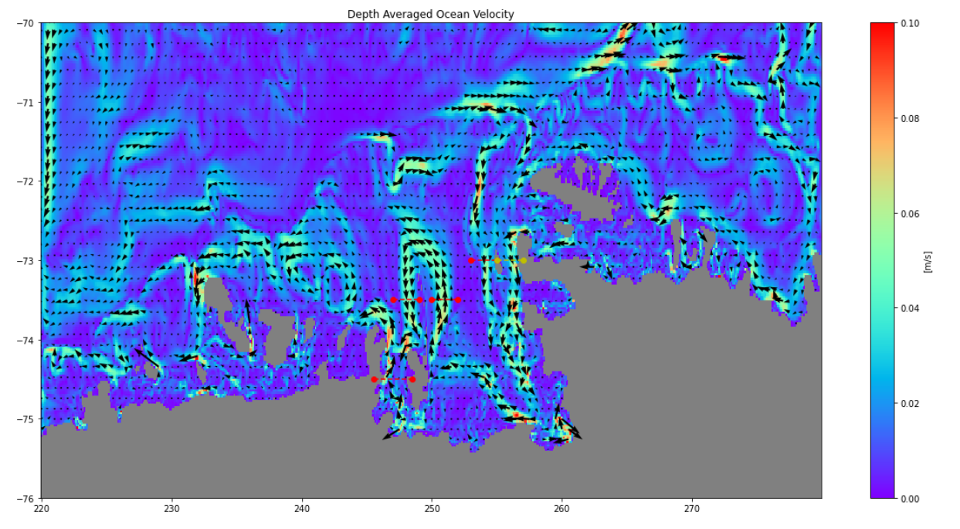
PITE
Burke
BRW
BRE
Dotson

Slide 4
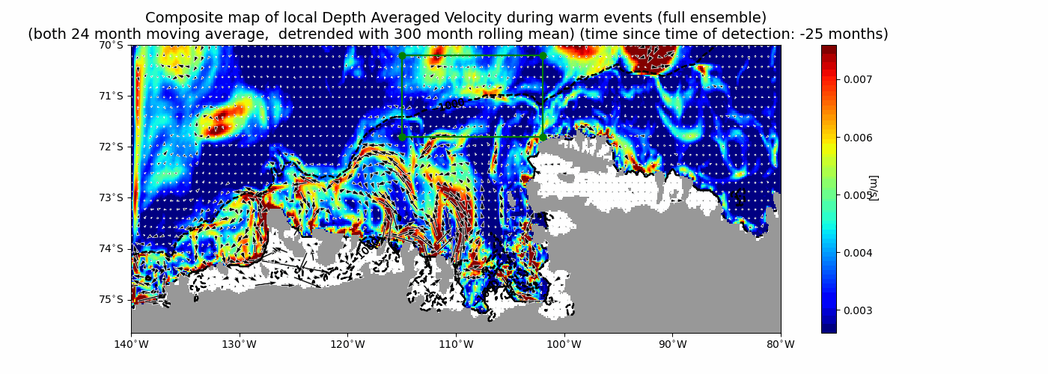

Slide 5
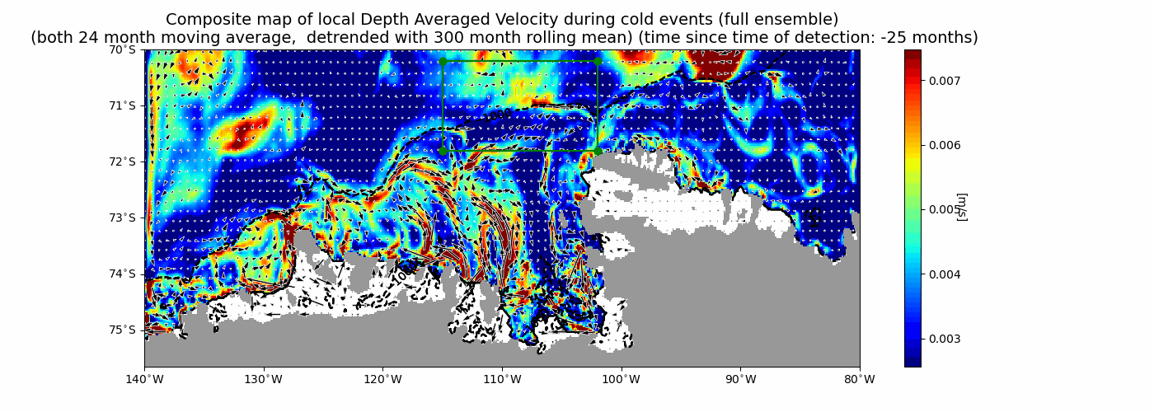

Slide 6
Ensemble Mean Response
Two types of responses:
‘Instantanious’
‘Integrated’

Slide 7
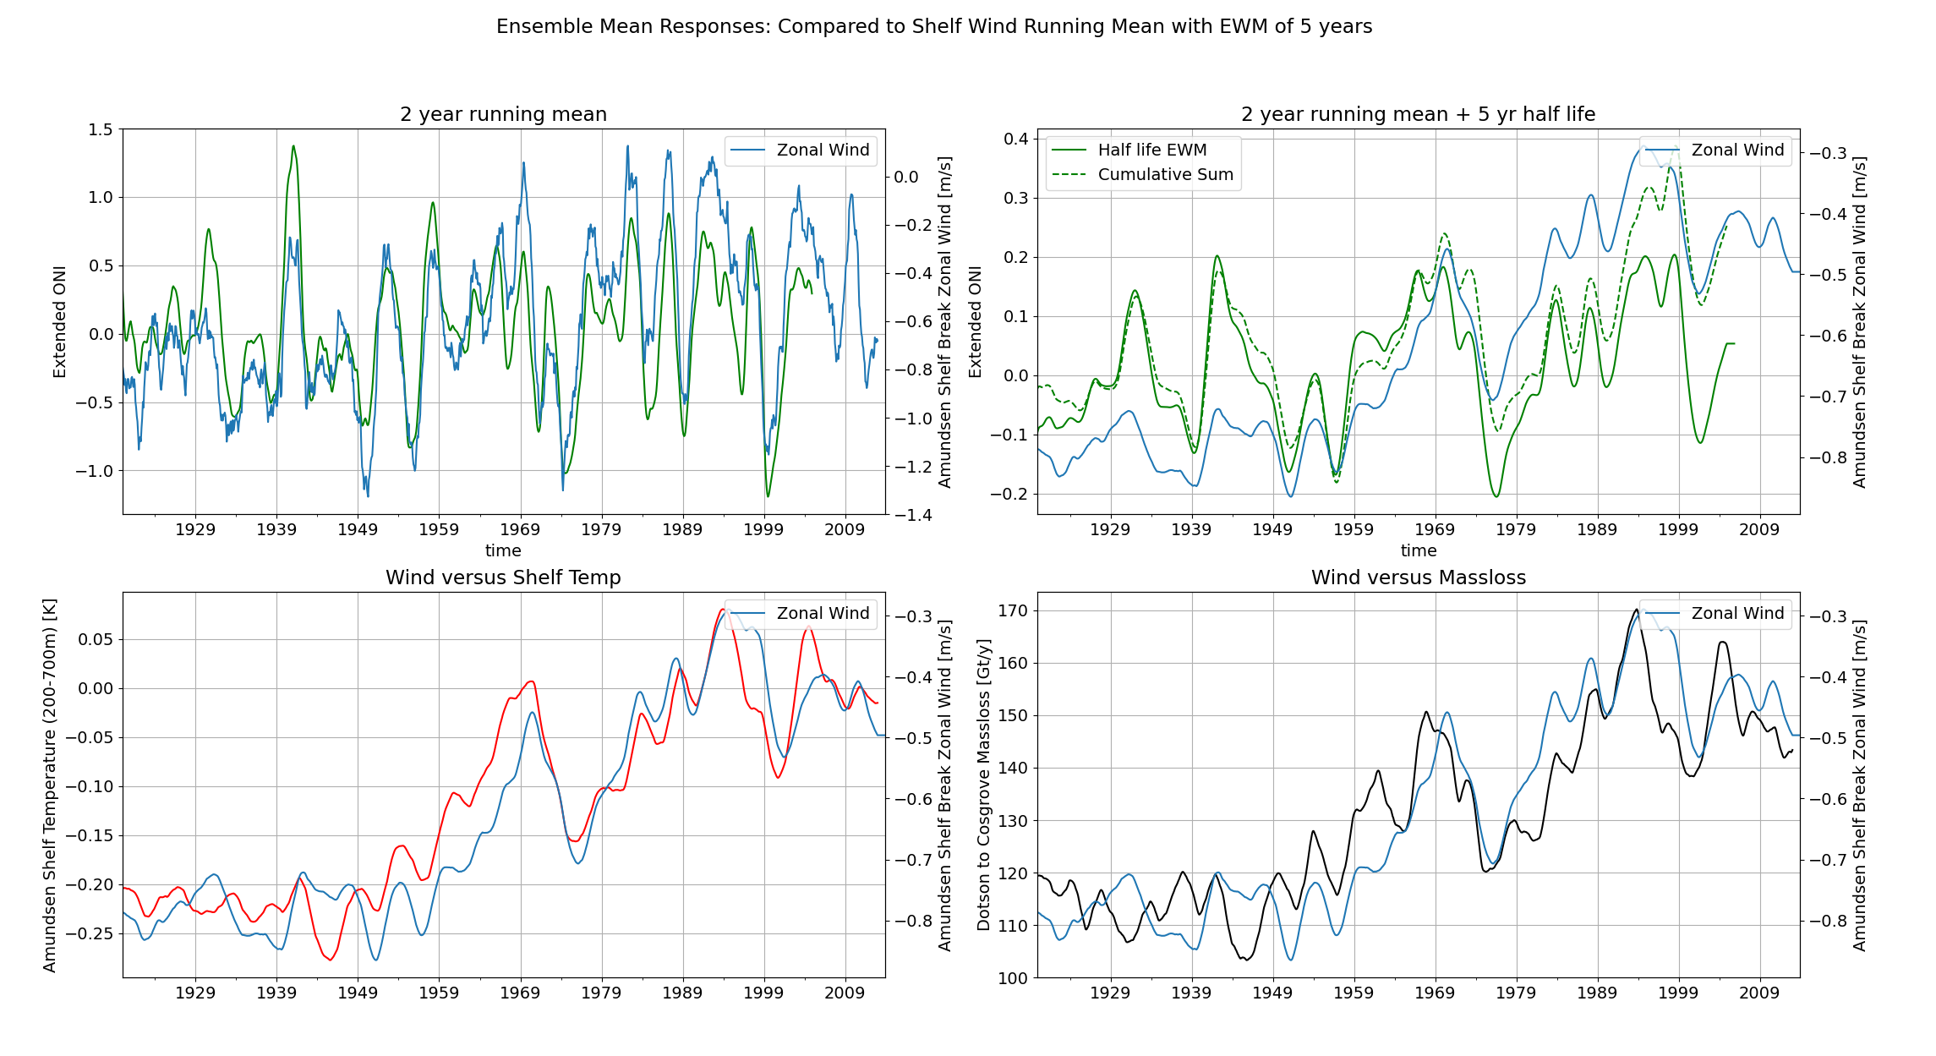

Slide 8
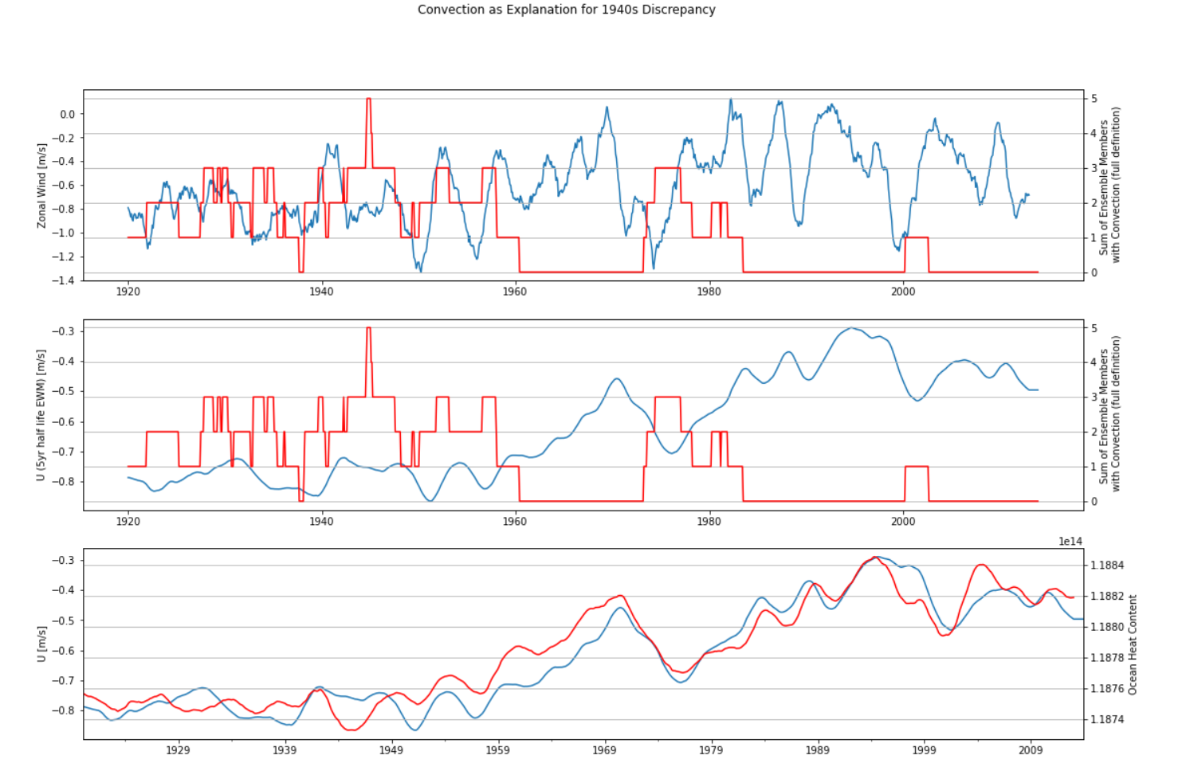

Slide 9
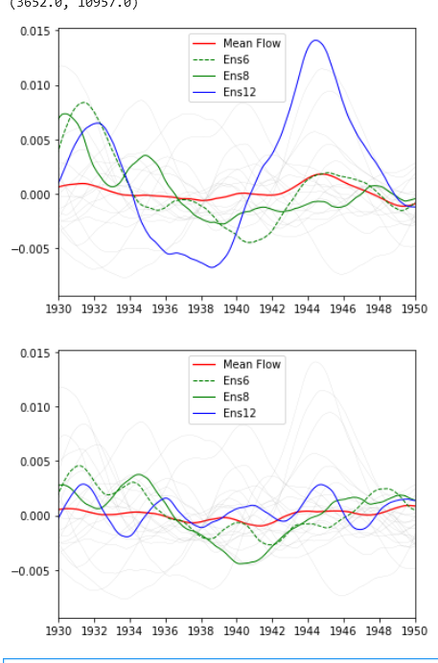
Depth Averaged Flow through PITE
Bottom 100m Flow through PITE

Slide 10
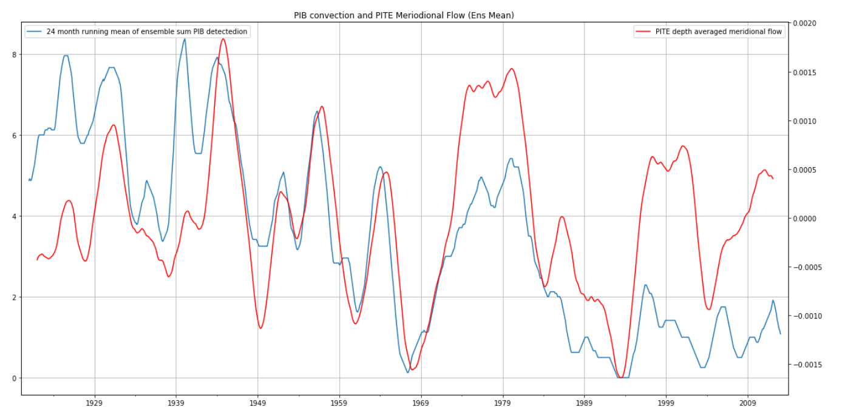
PITE Ensemble Mean Flow Determined by Strong Convection Outflow!

Slide 11
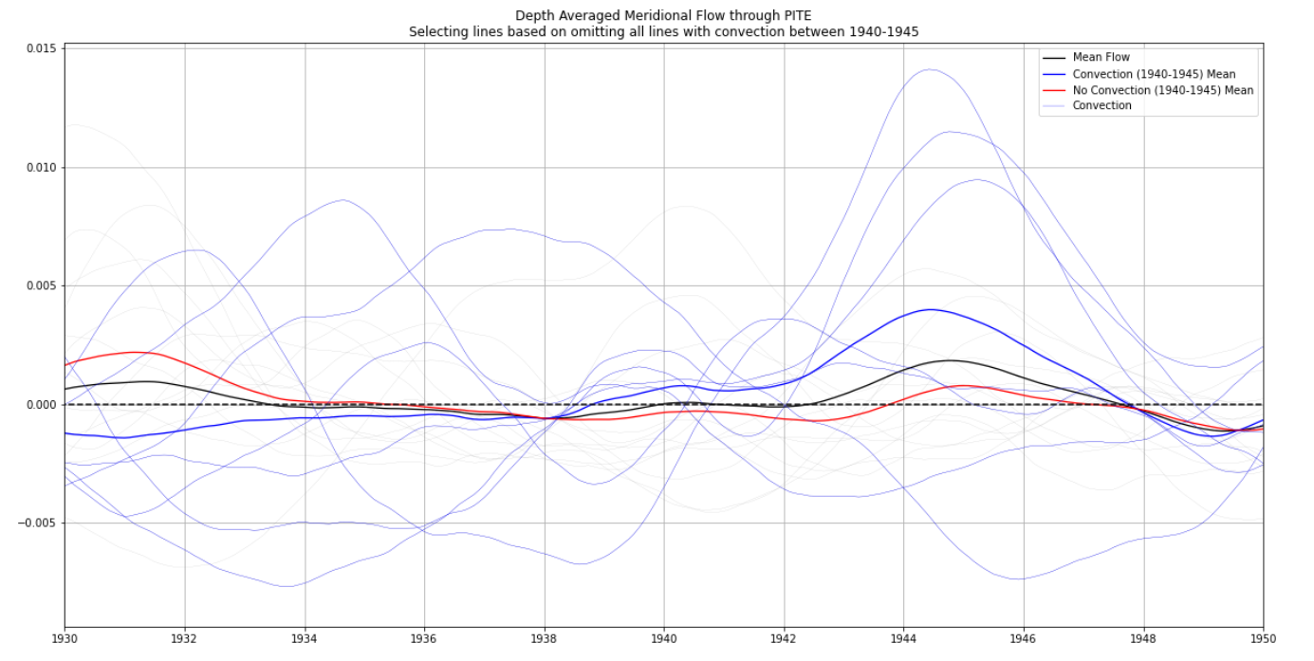
Convection seems to select strongest flows

Slide 12
How does the flow respond?

Slide 13
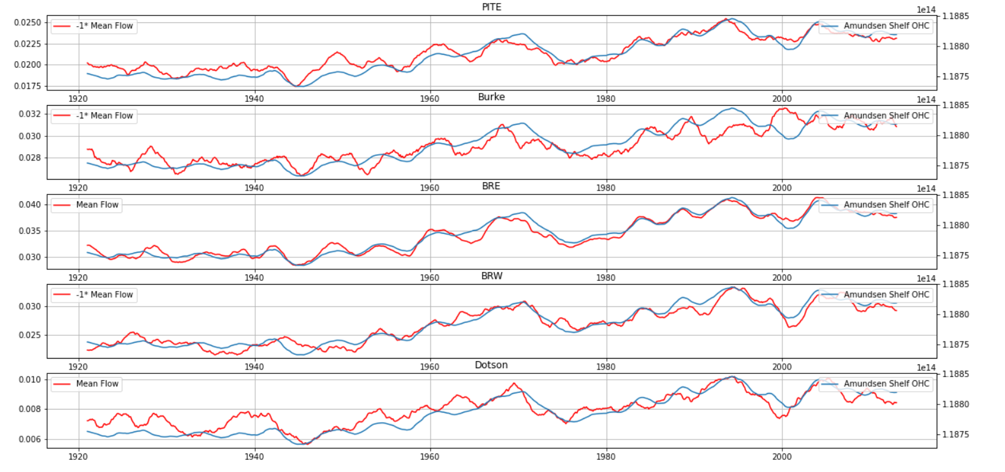
Depth Averaged Flow vs OHC: integrated response

Slide 14
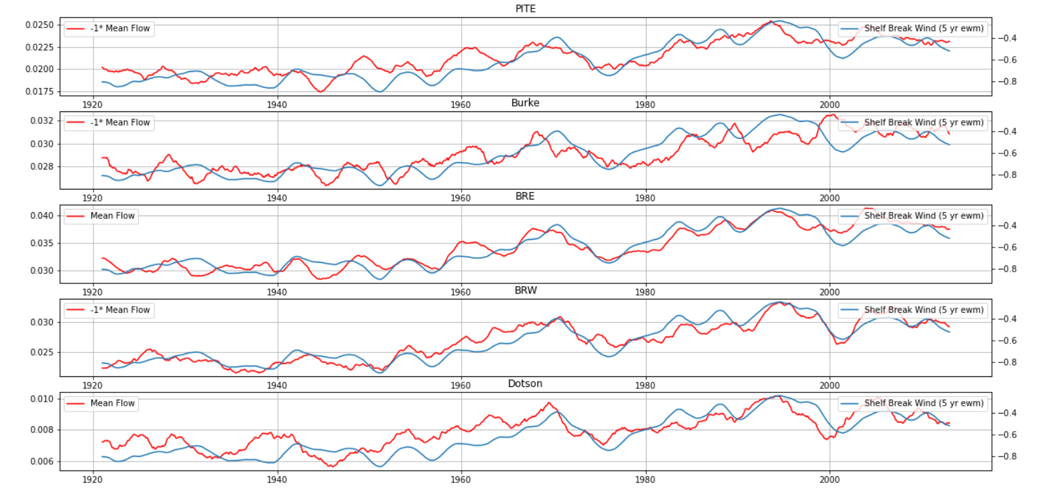
Depth Averaged Flow vs Weighted Wind

Slide 15
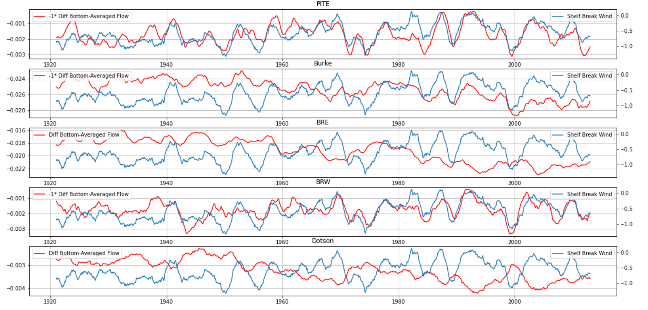
Bottom Flow Anomaly vs Wind: PITE Instantanious response

Slide 16
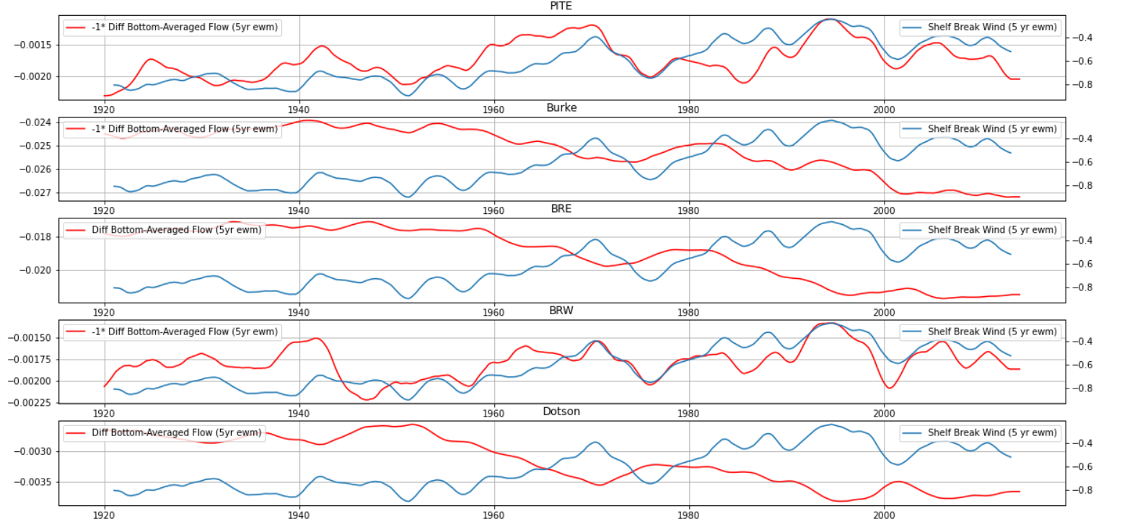
Weighted Bottom Flow Anomay vs Weighted Wind: Strong, but early 1940 response

Slide 17
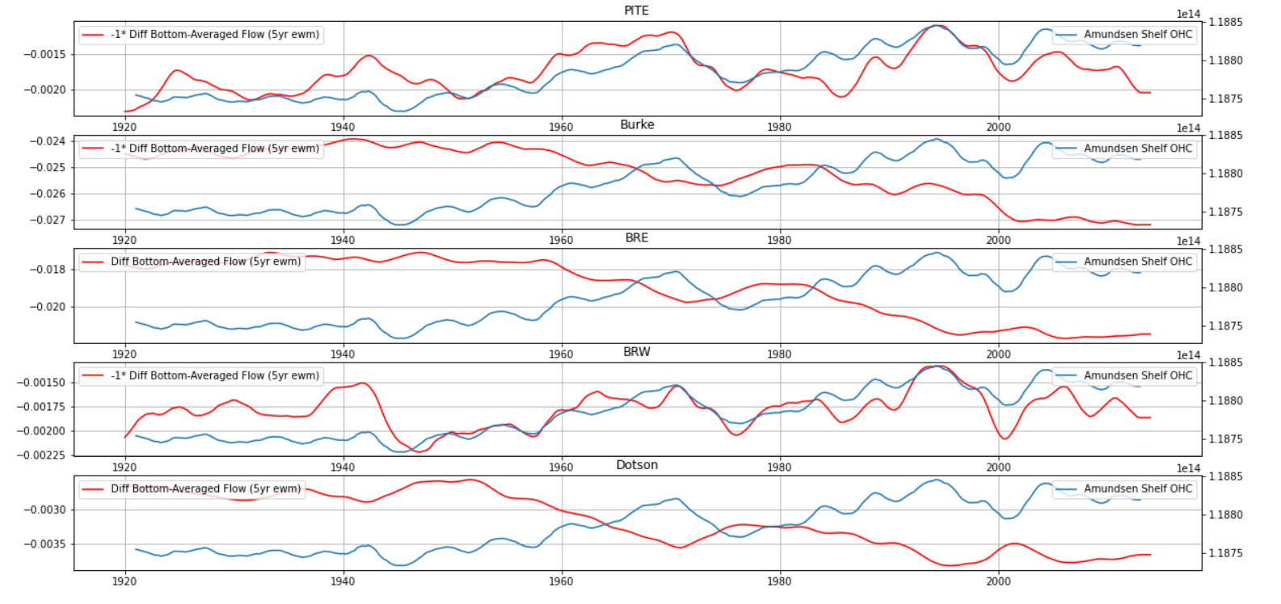
Weighted Bottom Flow Anomay vs OHC

Slide 19
How does the heat transport respond?

Slide 20
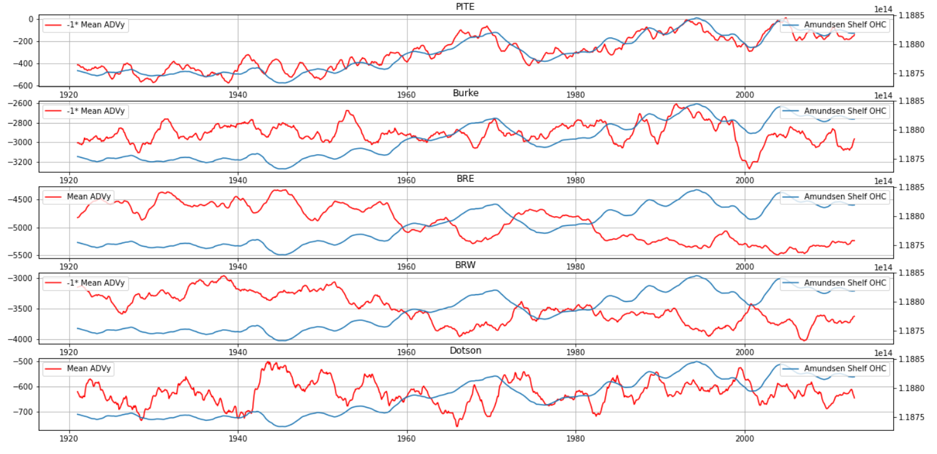
Mean Heat Transport is directed in opposite direction as expected;
More Instantanious Response

Slide 21
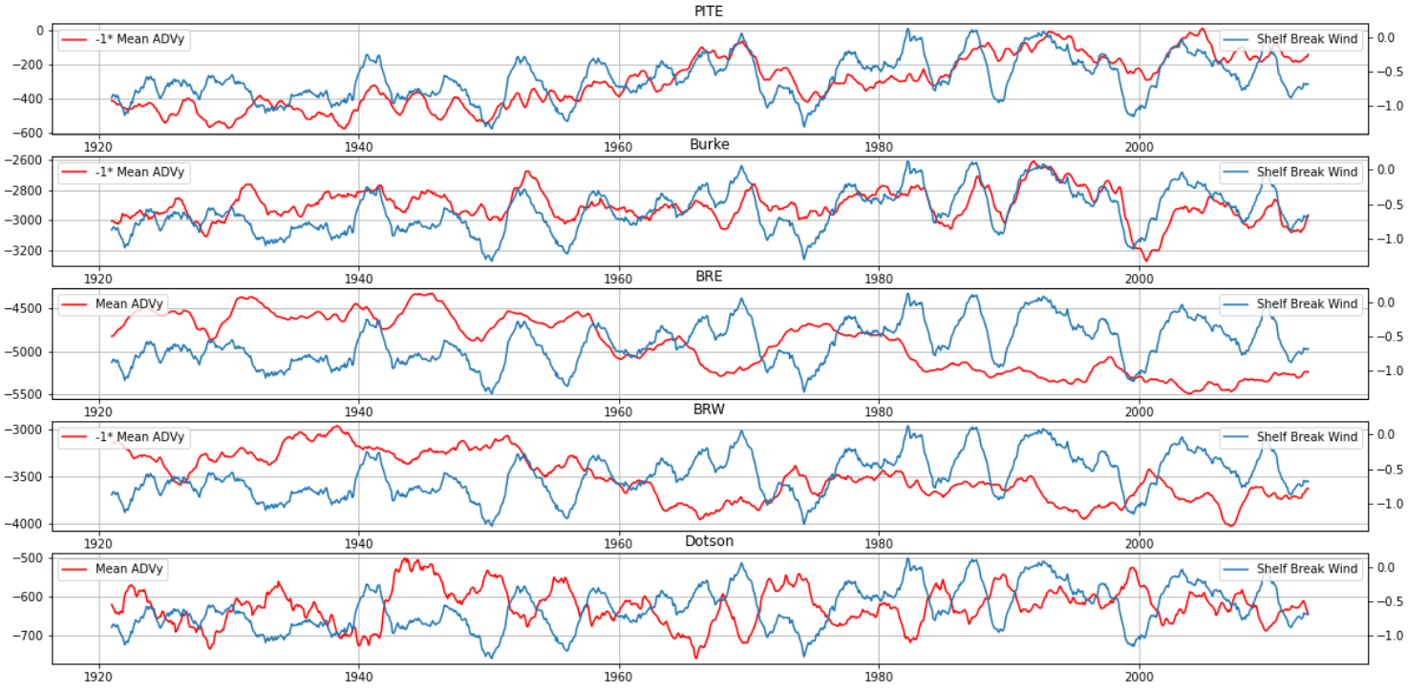
Anticorrelation?
Correlation
Instantanious correlation, integrated anticorrelation?

Slide 22
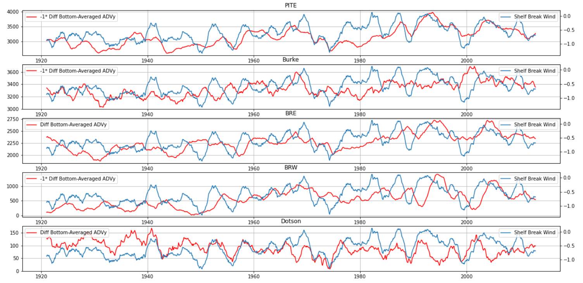
Baroclinic Heat Transport is directed in right direction (and stronger than mean!)
Instantanious wind influence is reduced, and stronger long term response→ Feedback effect of OHC?
Weak 1940s event is found here!

Slide 23
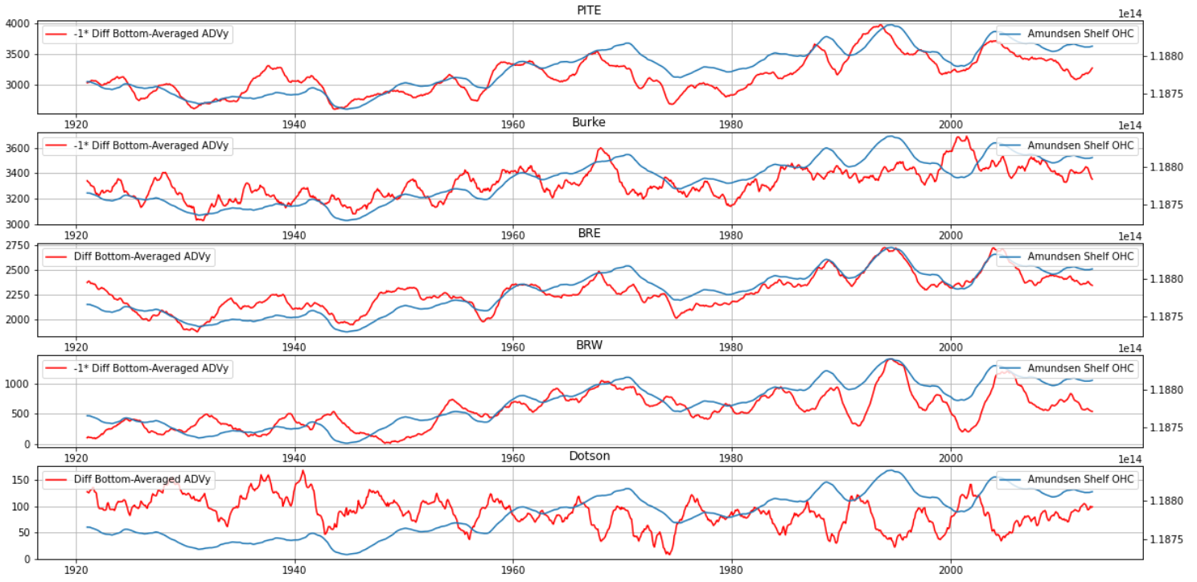

Slide 24
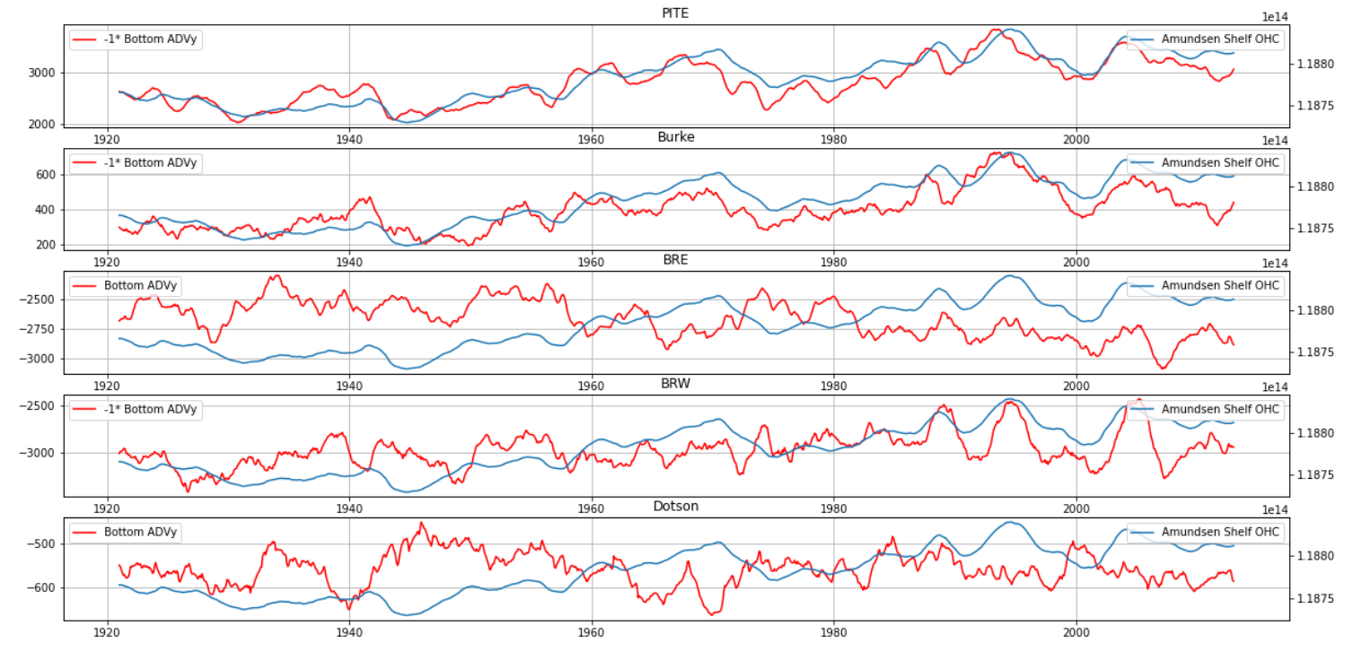

Slide 25
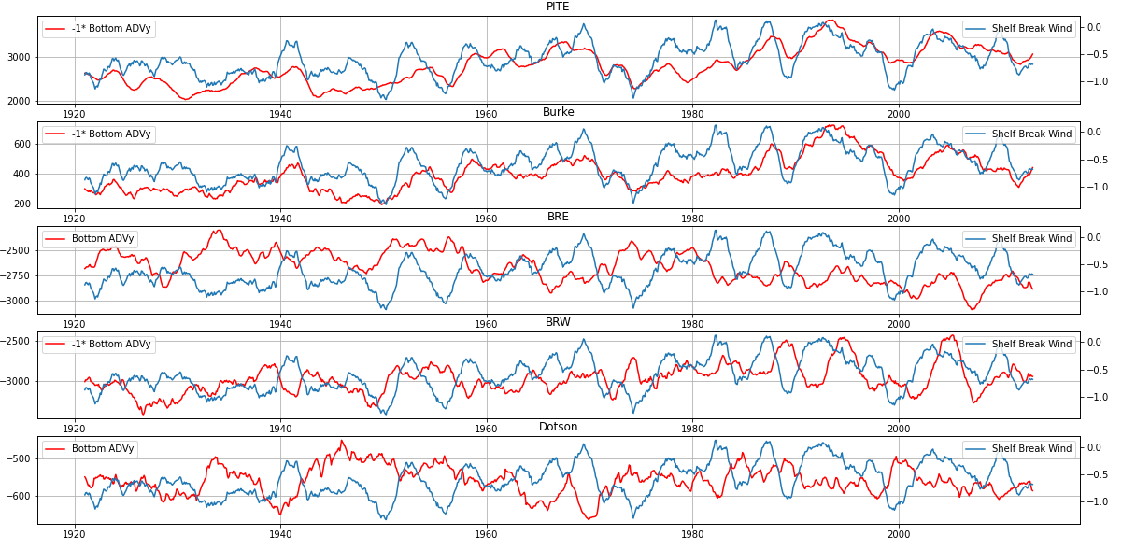

Slide 26
Subconclusion about Ensemble Mean
Long term ensemble mean flow seems roughly to respond to exponentially weighted mean of wind of 5 yr.
Barotropic flow and ocean heat content show this signature.
Baroclinic response directly governed by the wind, but interplay with long term influenced surroundings.
1940s response: - Present in ONI - Weaker in exponentially weighted wind→ because of trend and surroundings? - Weak in barotropic flow. - Present (and even a bit earlier and stronger!) in baroclinic flow - Weak in Baroclinic Heat transport - Thus in OHC. - Possibly concealed by widespread convection.

Slide 27
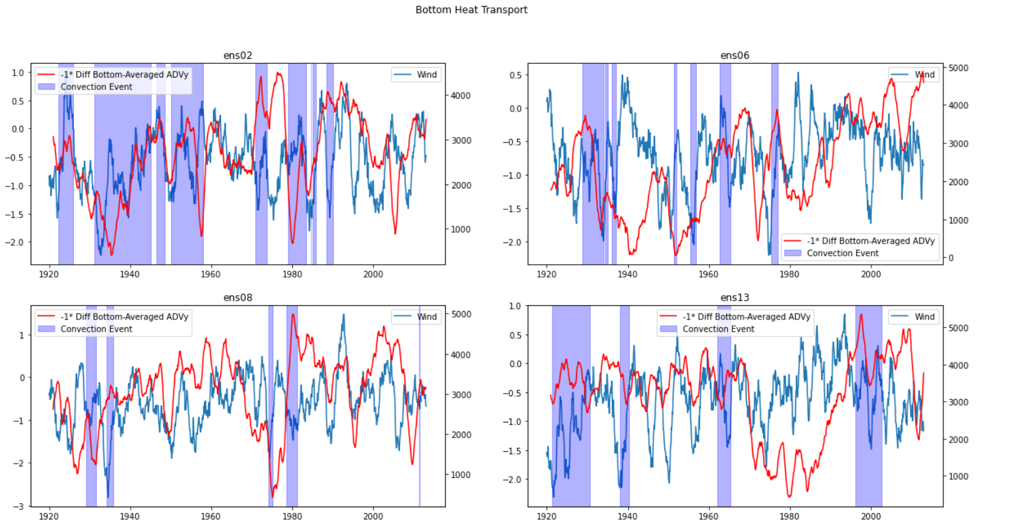

Slide 28
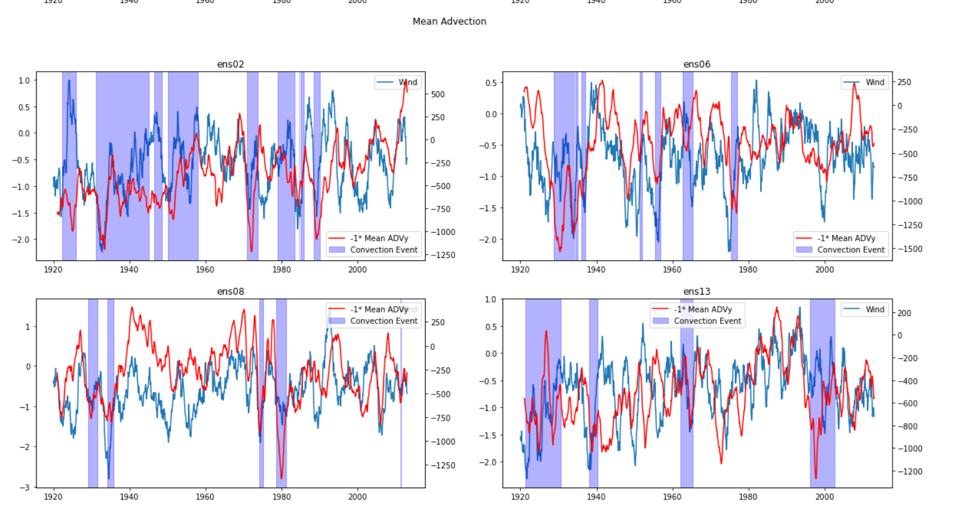

Slide 29
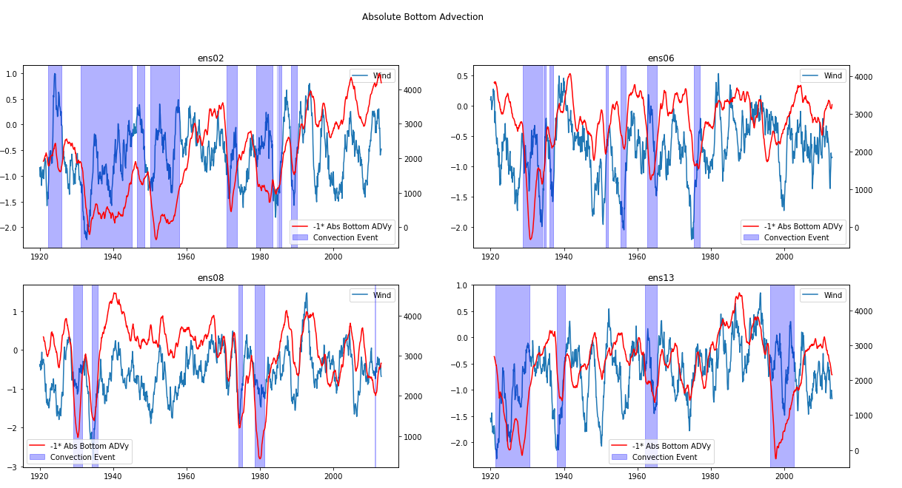
This is one step in the mechanism of convection

Slide 30
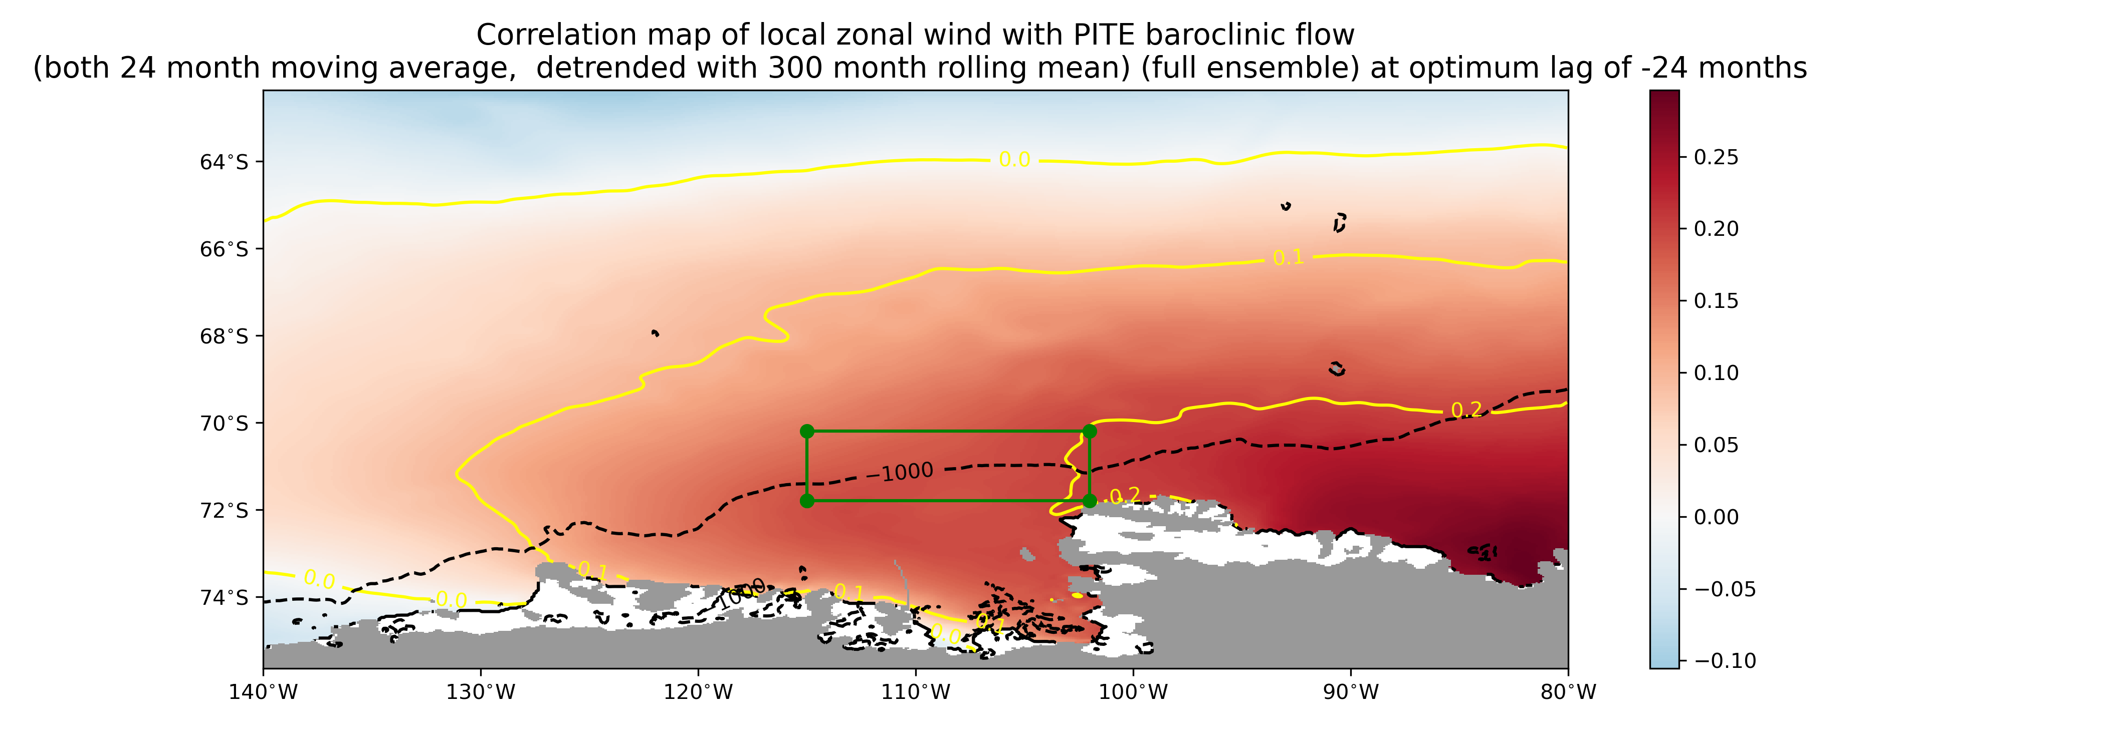

Slide 31
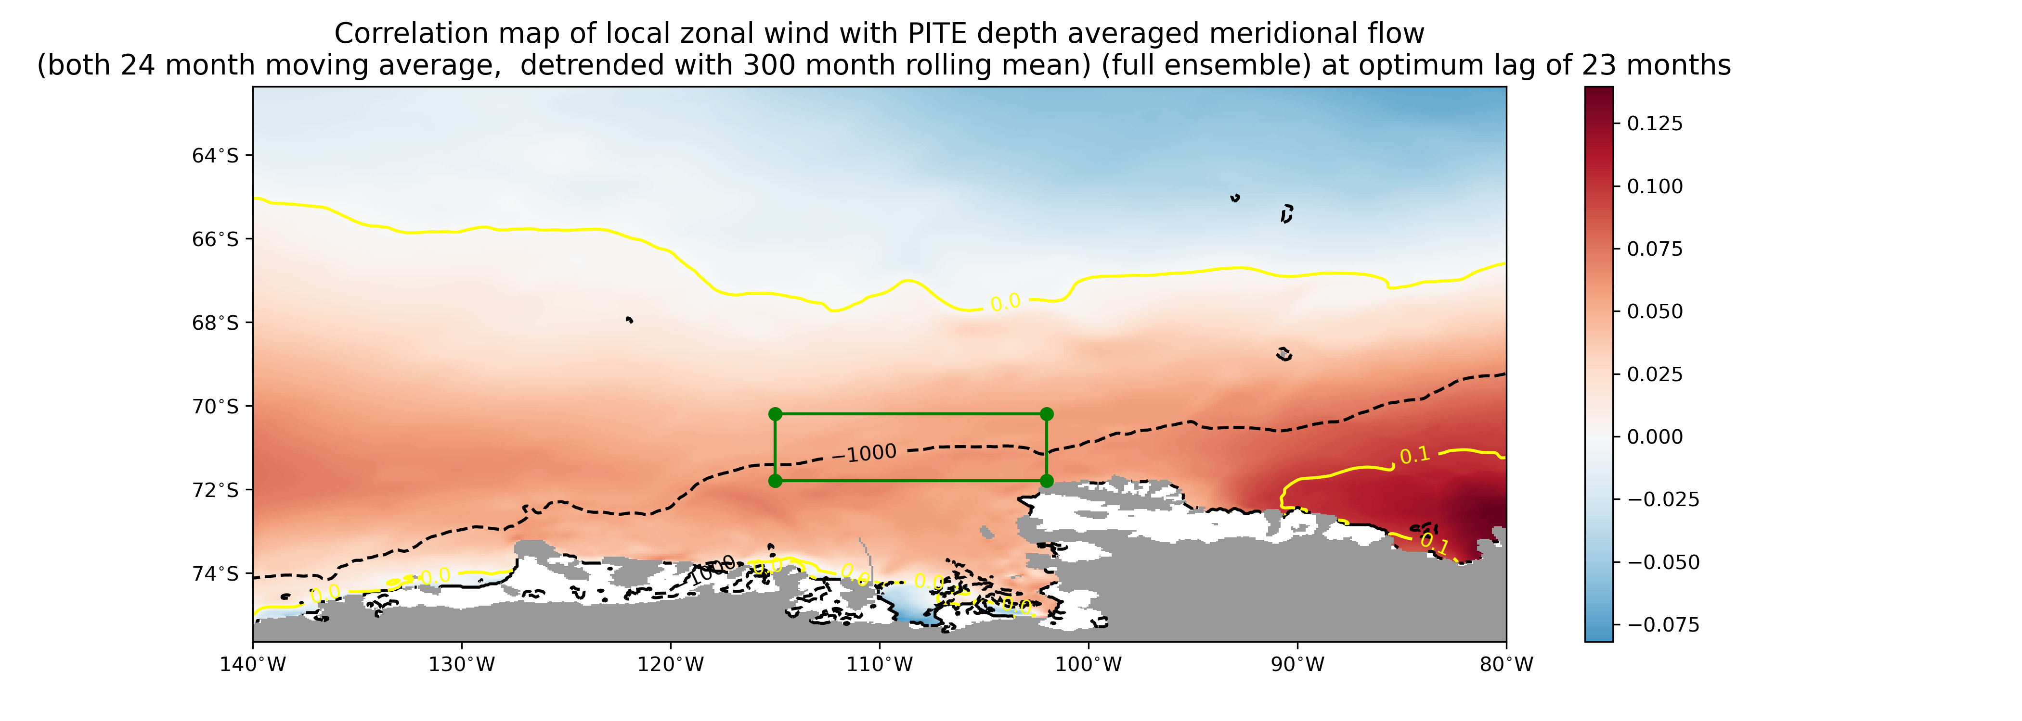

Slide 33
Interesting correlations

Slide 34
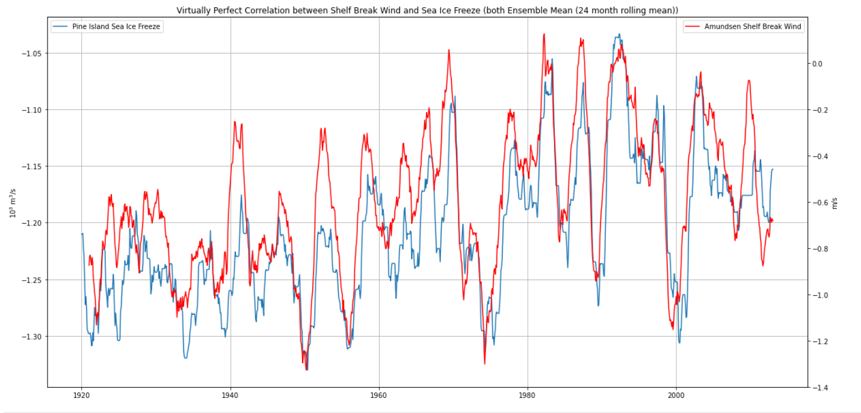

Slide 35
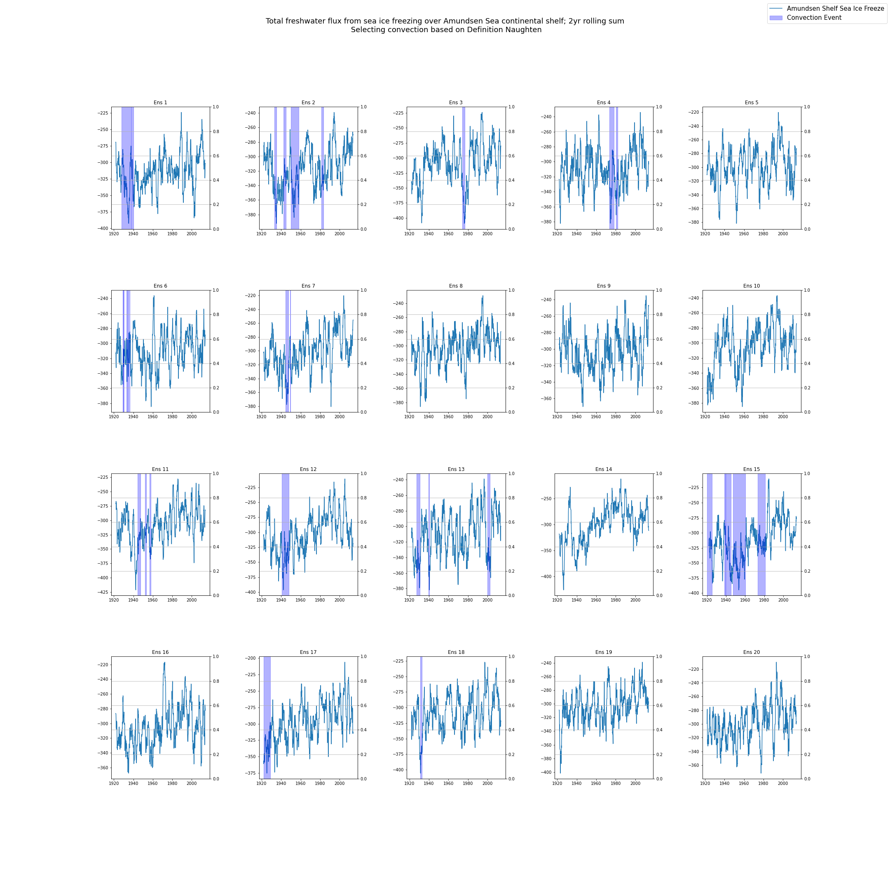

Slide 36
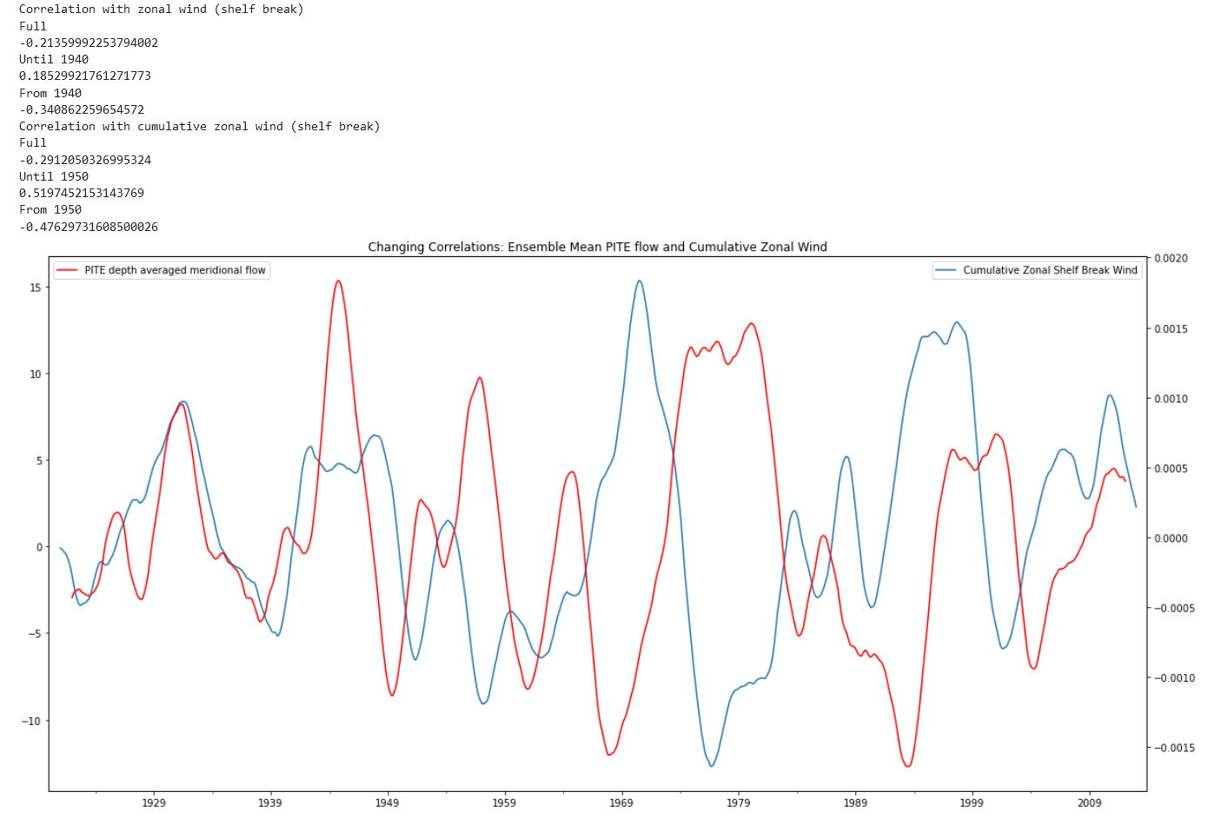
Negative Correlation
Towards positive again?
Positive Correlation

Slide 37
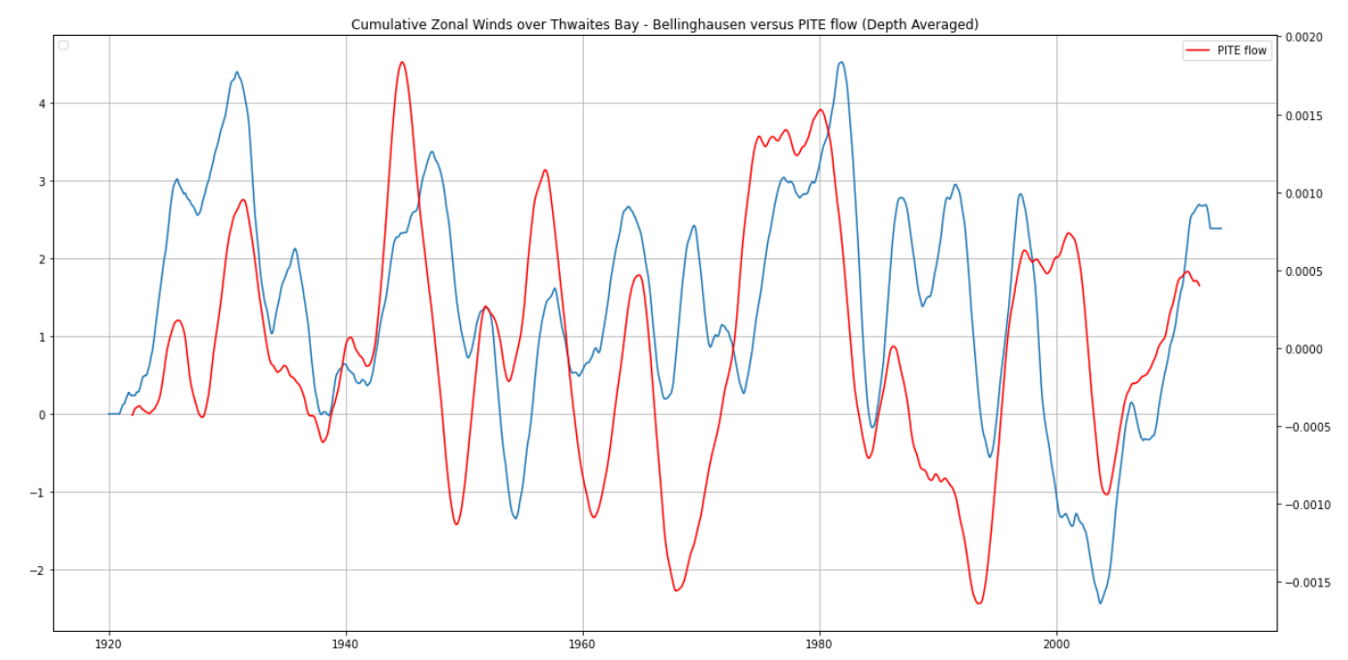
Correlation Remains (somewhat) positive!

Slide 38
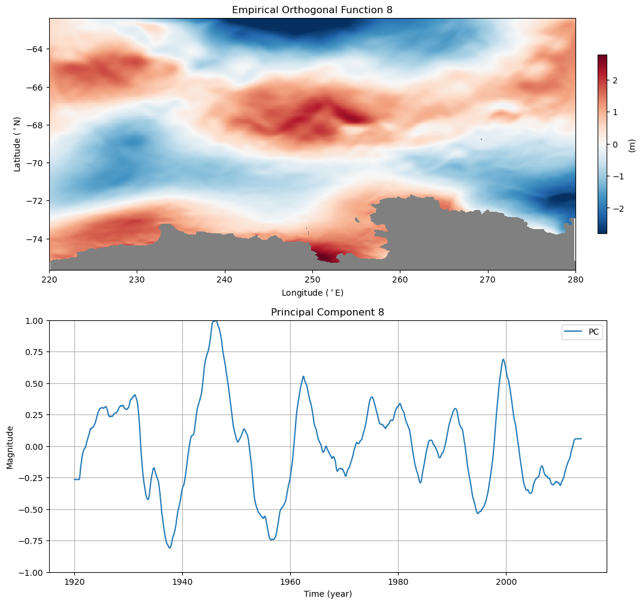

Slide 39
Questions

Slide 40
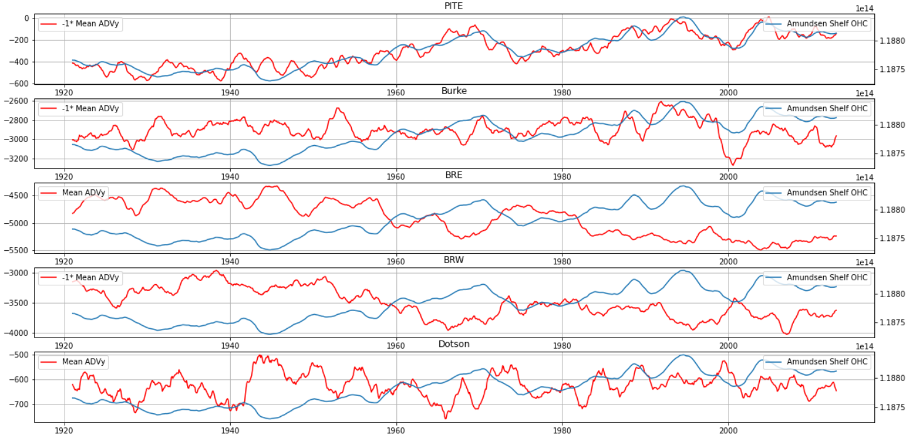

Slide 41
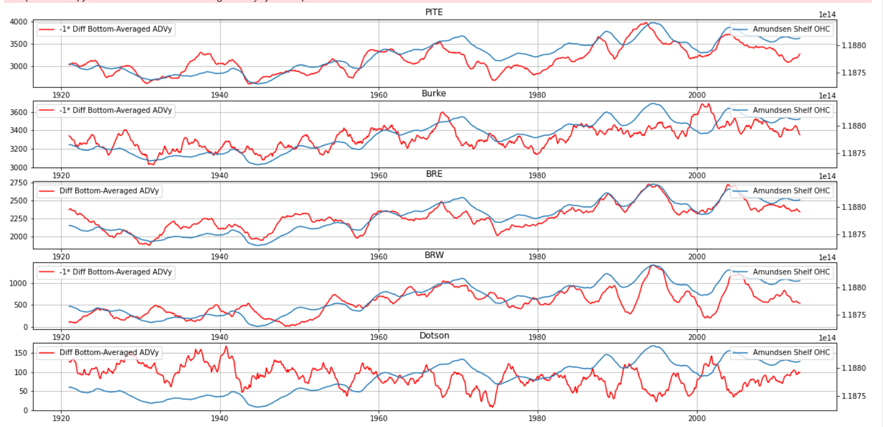

Slide 43
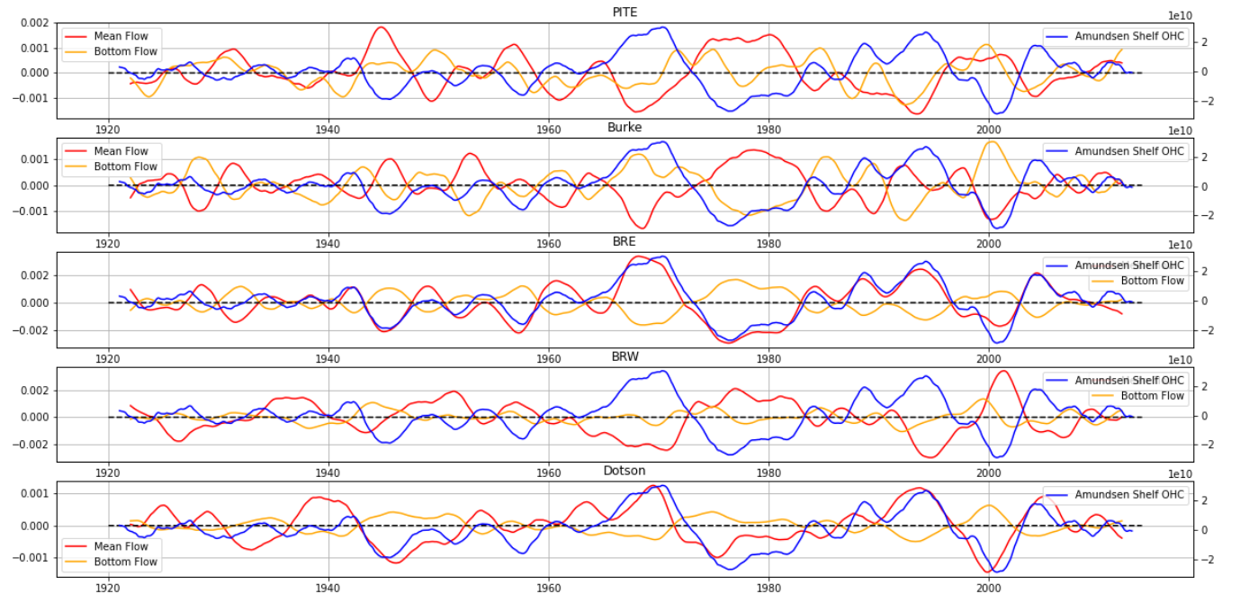

Slide 45
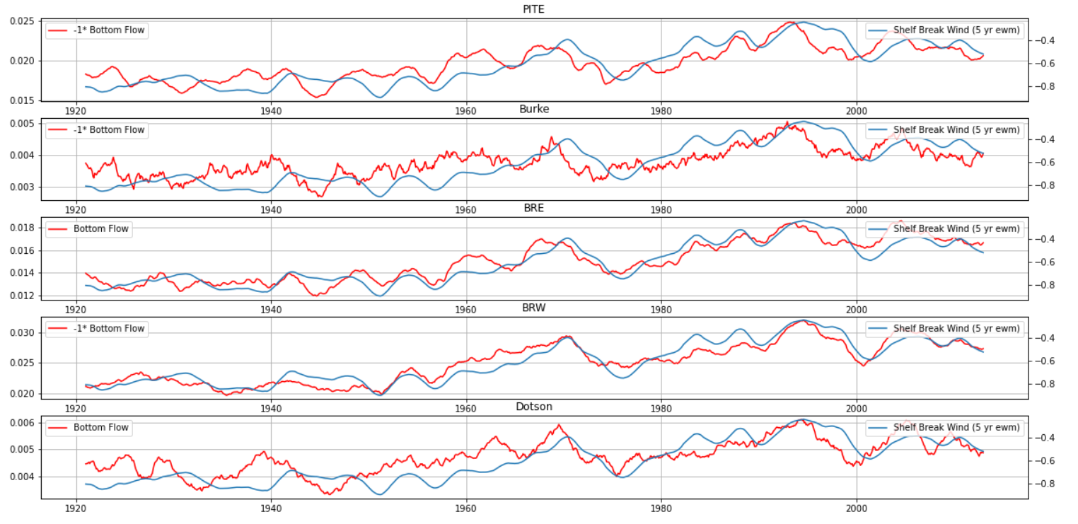
Bottom Flow vs Weighted Wind

Slide 46
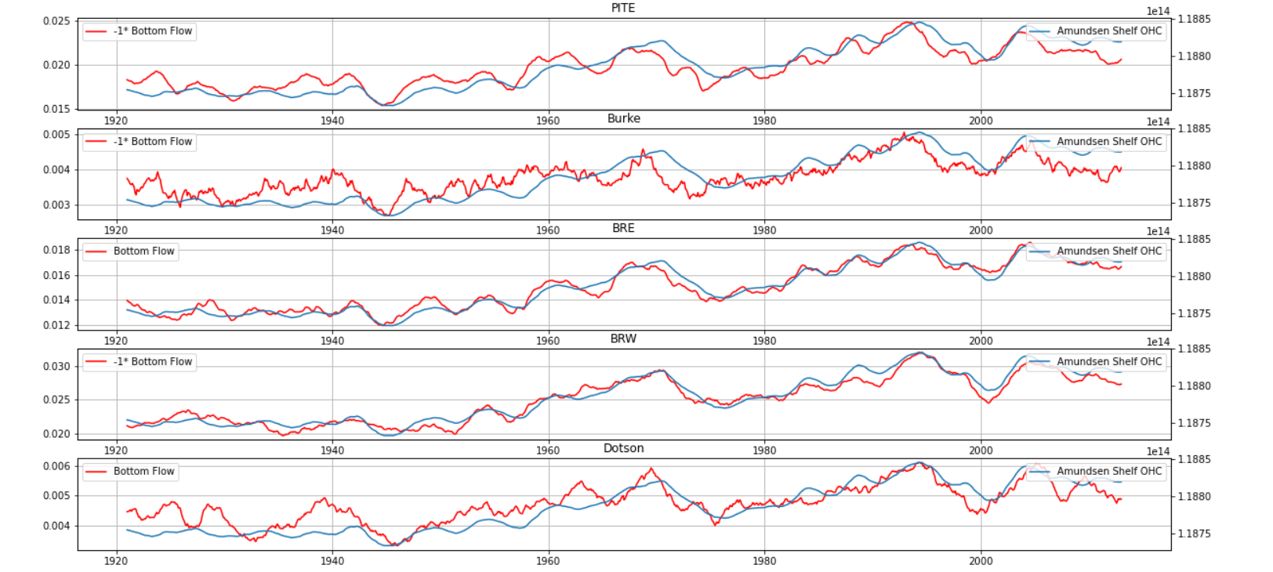

Slide 47
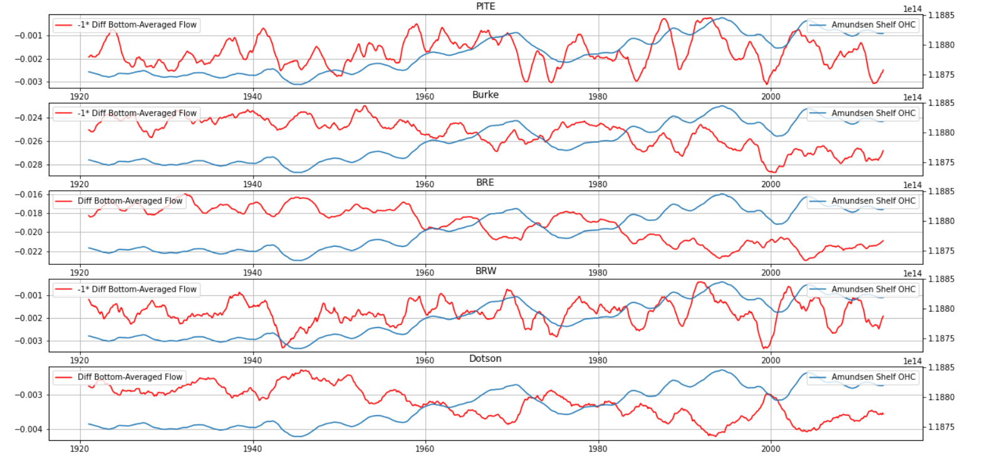

Slide 48
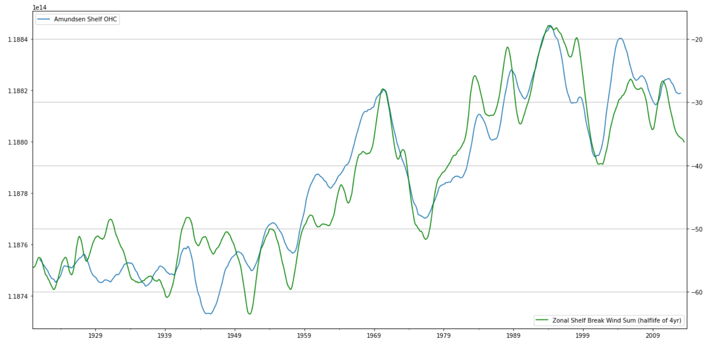

Slide 49
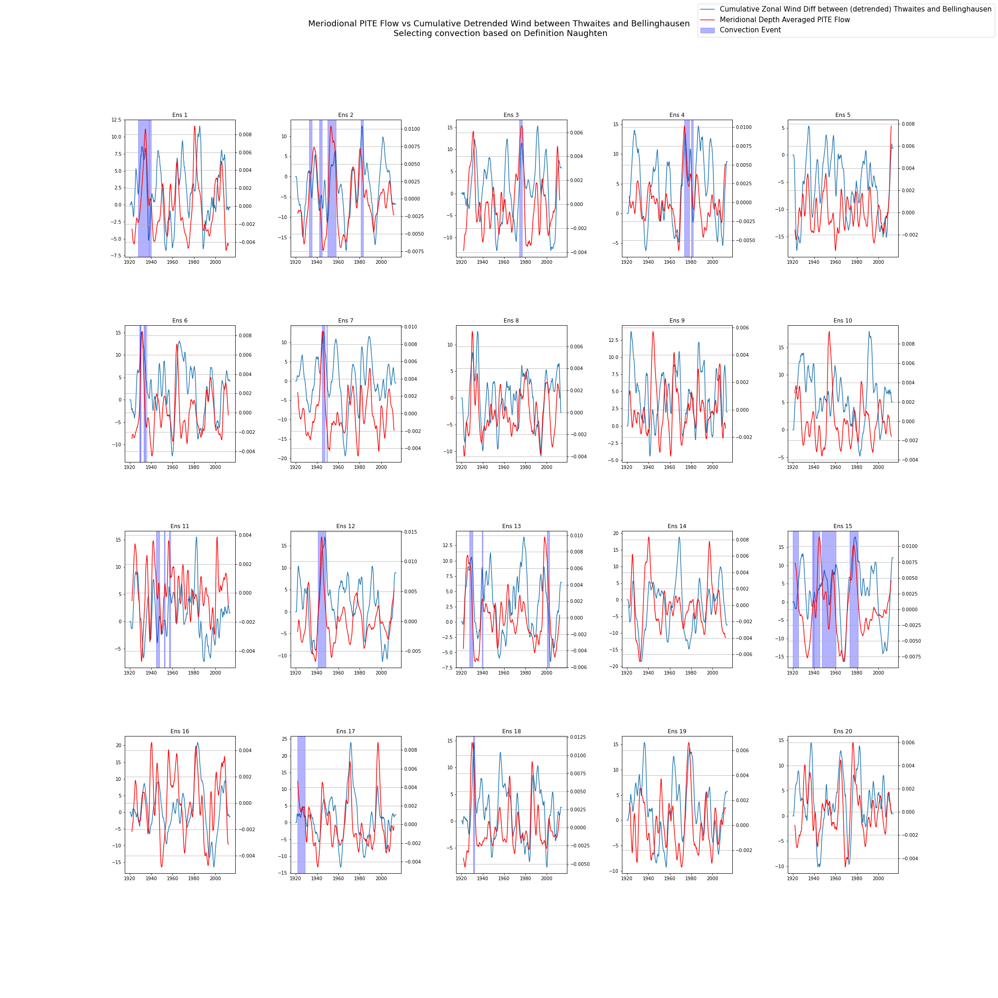

Slide 50
